Slide 1
FASTER STORAGE SYSTEM FOR FIRMS
Under guidance of
Mr/Dr. Sundara Murthy S,
Assistant Professor,
Information Technology,
BIT,
Sathy.
202IT251 – THARUN S
202IT172 - MOUNIKA M K

Slide 2
Abstract
The access of the data from the cloud storages are somewhat slow when compared to the local storages. But we are not using local storage because we cannot access the data remotely and they are hard to store in a single place (as generally we use cables to transfer files locally). This idea is to increase the data transfer and access speed using wifi for data transfer and storing them locally. Also making the server become cloud storage. In this paper, we take our past work above and beyond and present an inside and out investigation of the vital highlights of future enormous information stockpiling administrations for both unstructured and semi-organized information, what's more, talk about how such administrations ought to be developed and conveyed. We particularly center around the issues of information de-duplication for ventures and private associations. This research is especially significant for unpracticed arrangement suppliers like universities and exploration associations, and will permit them to quickly set up their own enormous information stockpiling administrations.

Slide 3
Problem Statement Addressed
The main problem of cloud storages is the speed of accessing the data. As we need to depend on the internet, even if we need to access a file of the company within the company, the user needs to access it through the internet and if there is any problem in the network then the situation will be a mess. Also another problem is the cost and the company needs to depend on the third party for their storages. Also security for the data comes into our picture in the case of cloud storage. Practically every form of data storage has the potential to be corrupted. Stray particles can interfere with most forms of data storage, and anything relying on magnetic strips or electric storage can be corrupted by electromagnetic interference.
Data security
Data Accessibility
Data Protection
Scalability
But, there are some challenges of Big Data encountered by companies. These include data quality, storage, lack of data science professionals, validating data, and accumulating data from different sources.

Slide 4
Existing Solution to the Problem Addressed
Many of us might have used applications like ShareIt, ShareMe, Mi Share, etc. By using this concept we can build a storage for an organization (or company).
This is all about network concepts. For basic transfer of files we need two devices i.e., one for hotspot and another for wifi (server and the other computers). When one device is connected with the other, a local network will be created within them. The connected devices will have distinct ip addresses. Now it will become easy to transfer files. When the sender selects the files and clicks send, the file is transferred through TCP and also the receiver is identified through the ip address of the device.
The file is actually transferred in chunk format and the speed of the transaction depends on the amount of chunks we transfer per unit of time. These chunk files are read at the sender’s side and they are written at the receiver’s side. The speed of the transaction also depends on the bandwidth of the network. Higher the bandwidth we use higher will be the speed of data transfer. So we can use this method to make data transactions within a company.

Slide 5
Proposed Solution to the Problem Addressed
One of the main advantages of cloud storage is the remote access of the data. So we should make it possible to make our project get completed. In this case we need to build an application that makes the data of the organization in the server to be accessed remotely. For the remote access of the data, the data should be available to access through the use of the internet. The application might just only be installed in the server system so that the user can access the data through the internet. This application will help the users to access the data outside the company also (will be very helpful if there are multiple branches). The application must have proper cryptographic encryption and decryption methods to ensure the safety of the data. The internet is only required for the server system. The receiver should install the same application or to use a particular website to access the data in the server.
Since the security for the server is high, we can set some credentials to access the data through the website and the application so that no third party can access our data.
However distributed computing may not appear to be legit experiencing the same thing, there are a few use cases that have obvious advantages and ought not be overlooked.

Slide 6
Project Work Plan
The companies need to buy a server system with a powerful router to connect other computers together to that server. The extenders can also be used to extend the wifi coverage within the company. The security methods like WPA, etc, to be set for the router. When the routers are turned on, the computers within the organizations can be connected to the server. The file transfer can be done using this wifi hotspot method mentioned above. Then the developed application should be installed in the server system and the internet connection to be given to the server to make the data to be accessed through the internet.
The project work plan is, We have depicted the plan and execution of CACSS, a major information stockpiling framework, considering the nonexclusive standards of information stockpiling effectiveness and toughness, adaptability, execution and dependability. CACSS has been sent on top of IC-Cloud framework starting around 2012 and has filled in as the primary extra room for a few inside and outer cooperative activities. We have seen improvement in execution with object storing empowered through primer trials. In any case, there is still a lot of progress and assessment work to be done on the recently added elements, for example, object information de-duplication and item information reserving administrations. These elements will be tended to and their adequacy approved in our future work.

Slide 7
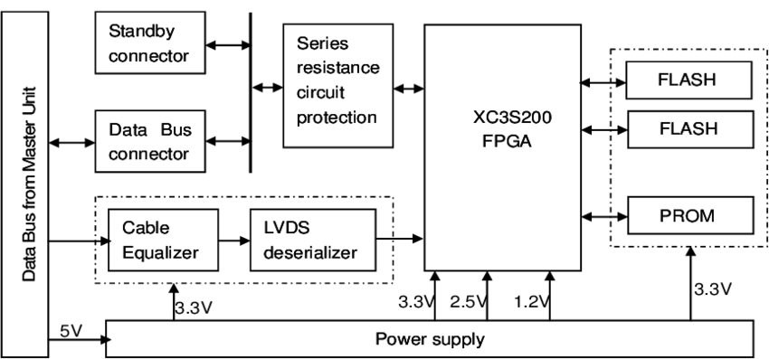
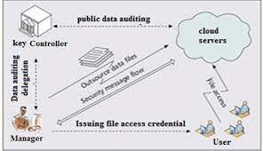
Block Diagram and/or Circuit Diagram

Slide 8
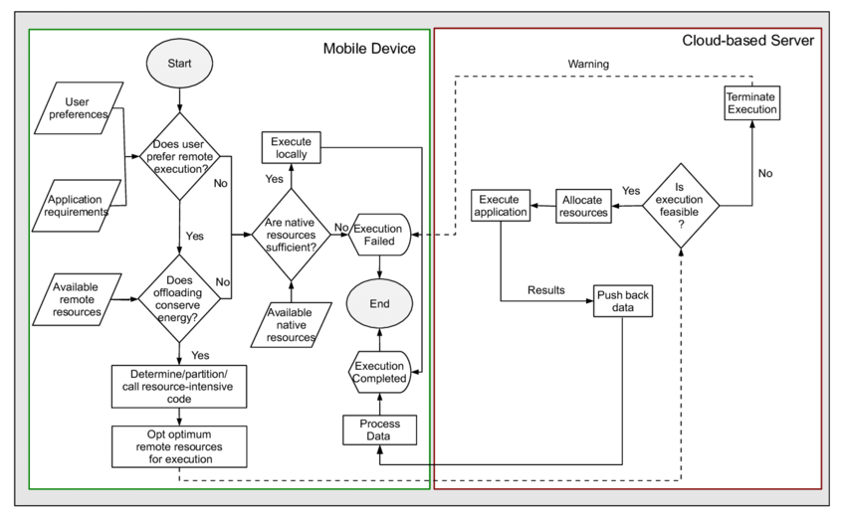
Flow Chart

Slide 9
Effective utilization of the Modern Tool & Cloud
Unlike local storage, cloud storage relieves end users of the task of upgrading their storage devices constantly. Cloud storage services enable inexpensive, secure, fast, reliable and highly scalable data storage solutions over the internet. Leading cloud storage vendors, such as (Amazon) and (Google) , provide clients with highly available, low cost and pay as you go based cloud storage services with no upfront cost.
In order to reveal this secret knowledge behind cloud storage services and thereby a generic solution, we present CACSS, a generic computational and adaptive cloud storage system that adapts existing storage technologies to provide efficient and scalable services. Through a demonstration of CACSS, full details can be given of how a proper cloud storage service can be constructed, in consideration of its design rationale, system architecture and implementation.

Slide 10
We also show that our system not only supports the mainstream cloud storage features —such as well supported scalability, sufficient replications and versioning— but that it also supports large scale metadata operations such as metadata searching. These features provide a generic basis that enables potential storage service providers, both internet wide and intranet wide, to setup their “private S3”. Furthermore, CACSS is designed at petabyte scale and can be deployed across multiple data centres in different regions around the world.

Slide 11
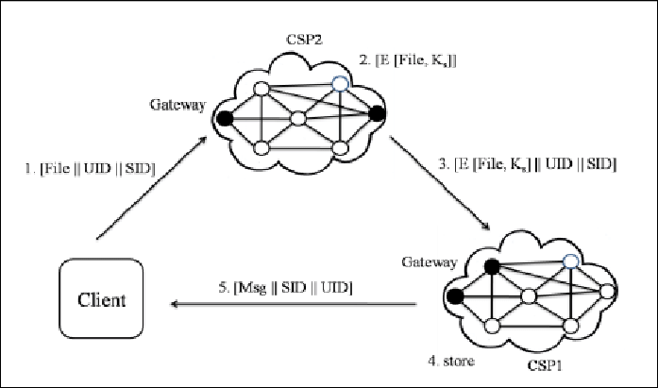
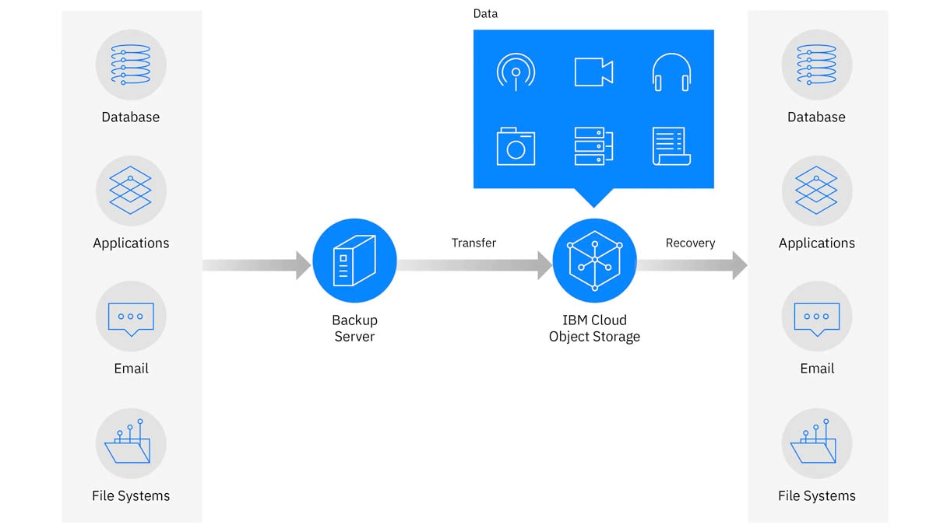
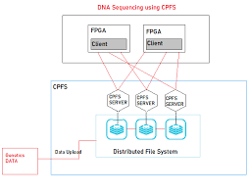
Technology stack & use case

Slide 12
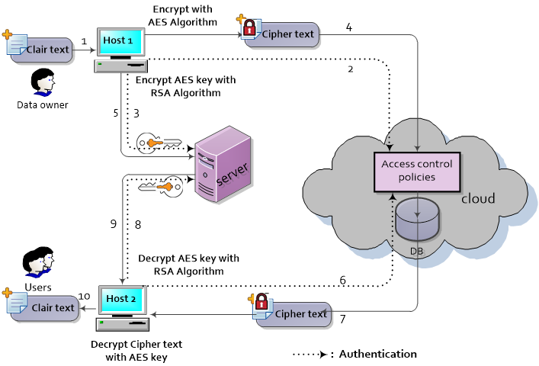
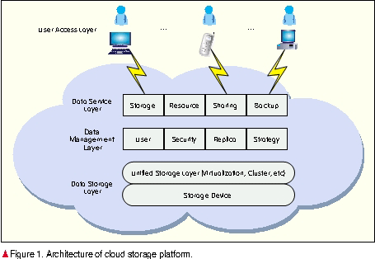
Prototype & Sample Output

Slide 13
Analysis of Results & Discussions
The companies need to buy a server system with a powerful router to connect other computers together to that server. The extenders can also be used to extend the wifi coverage within the company. The security methods like WPA, etc, to be set for the router. When the routers are turned on, the computers within the organizations can be connected to the server. The file transfer can be done using this wifi hotspot method mentioned above. Then the developed application should be installed in the server system and the internet connection to be given to the server to make the data to be accessed through the internet.
One of the main advantages of cloud storage is the remote access of the data. So we should make it possible to make our project get completed. In this case we need to build an application that makes the data of the organization in the server to be accessed remotely. For the remote access of the data, the data should be available to access through the use of the internet.

Slide 14
Cost Benefit Analysis (List of Components / Service Used)
S.No | Component Name | Specification (IC number or Range or Value) | Unit Cost | Total Cost
1. | Unit price of class A software | NA | Dollars | Dollars
2. | Server Utilization Class A (percentage of unit price that accounts for the annual cost) | NA | Pecentage | Percentage
3. | Network Cost | NA | $650 | $3,351
4. | Software, Support and Maintenance Cost | NA | $400 | $15,000
5. | Cost of servers and Data centers | NA | $10 million to $25 million | $10 million to $25 million

Slide 15
References
Ajzen, I., 1991. The theory of planned behavior. Organ. Behav. Hum. Decis. Process. 50 (2), 179–211. Bauer, R.A., 1960. Consumer behavior as risk taking. In: Robert, S.H. (Ed.), Dynamic Marketing for a Changing World. American Marketing Association, Chicago, pp. 389–398
Bolton, R.N., Drew, J.H., 1991. A multistage model of customers' assessments of service quality and value. J. Consum. Res. 17 (4), 375–384. Chan, J.W., Chang, V.L., Lau, W.K., Law, L.K., Lei, C.J., 2016. Taxi App market analysis in Hong Kong. J. Econ., Bus. Manage. 4 (3), 239–242.Chen, S.C., Jong, D., Lai, M.T., 2014. Assessing the relationship between technology readiness and continuance intention in an E-appointment system: relationship quality as a mediator. J. Med. Syst. 38 (9), 1–12.
https://searchstorage.techtarget.com/defin ition/cloud storage/
Gilbert, H. and H. Handschuh. Security analysis of SHA-256 and sisters. in Selected Areas in Cryptography. 2004. Springer.

